Slide 1
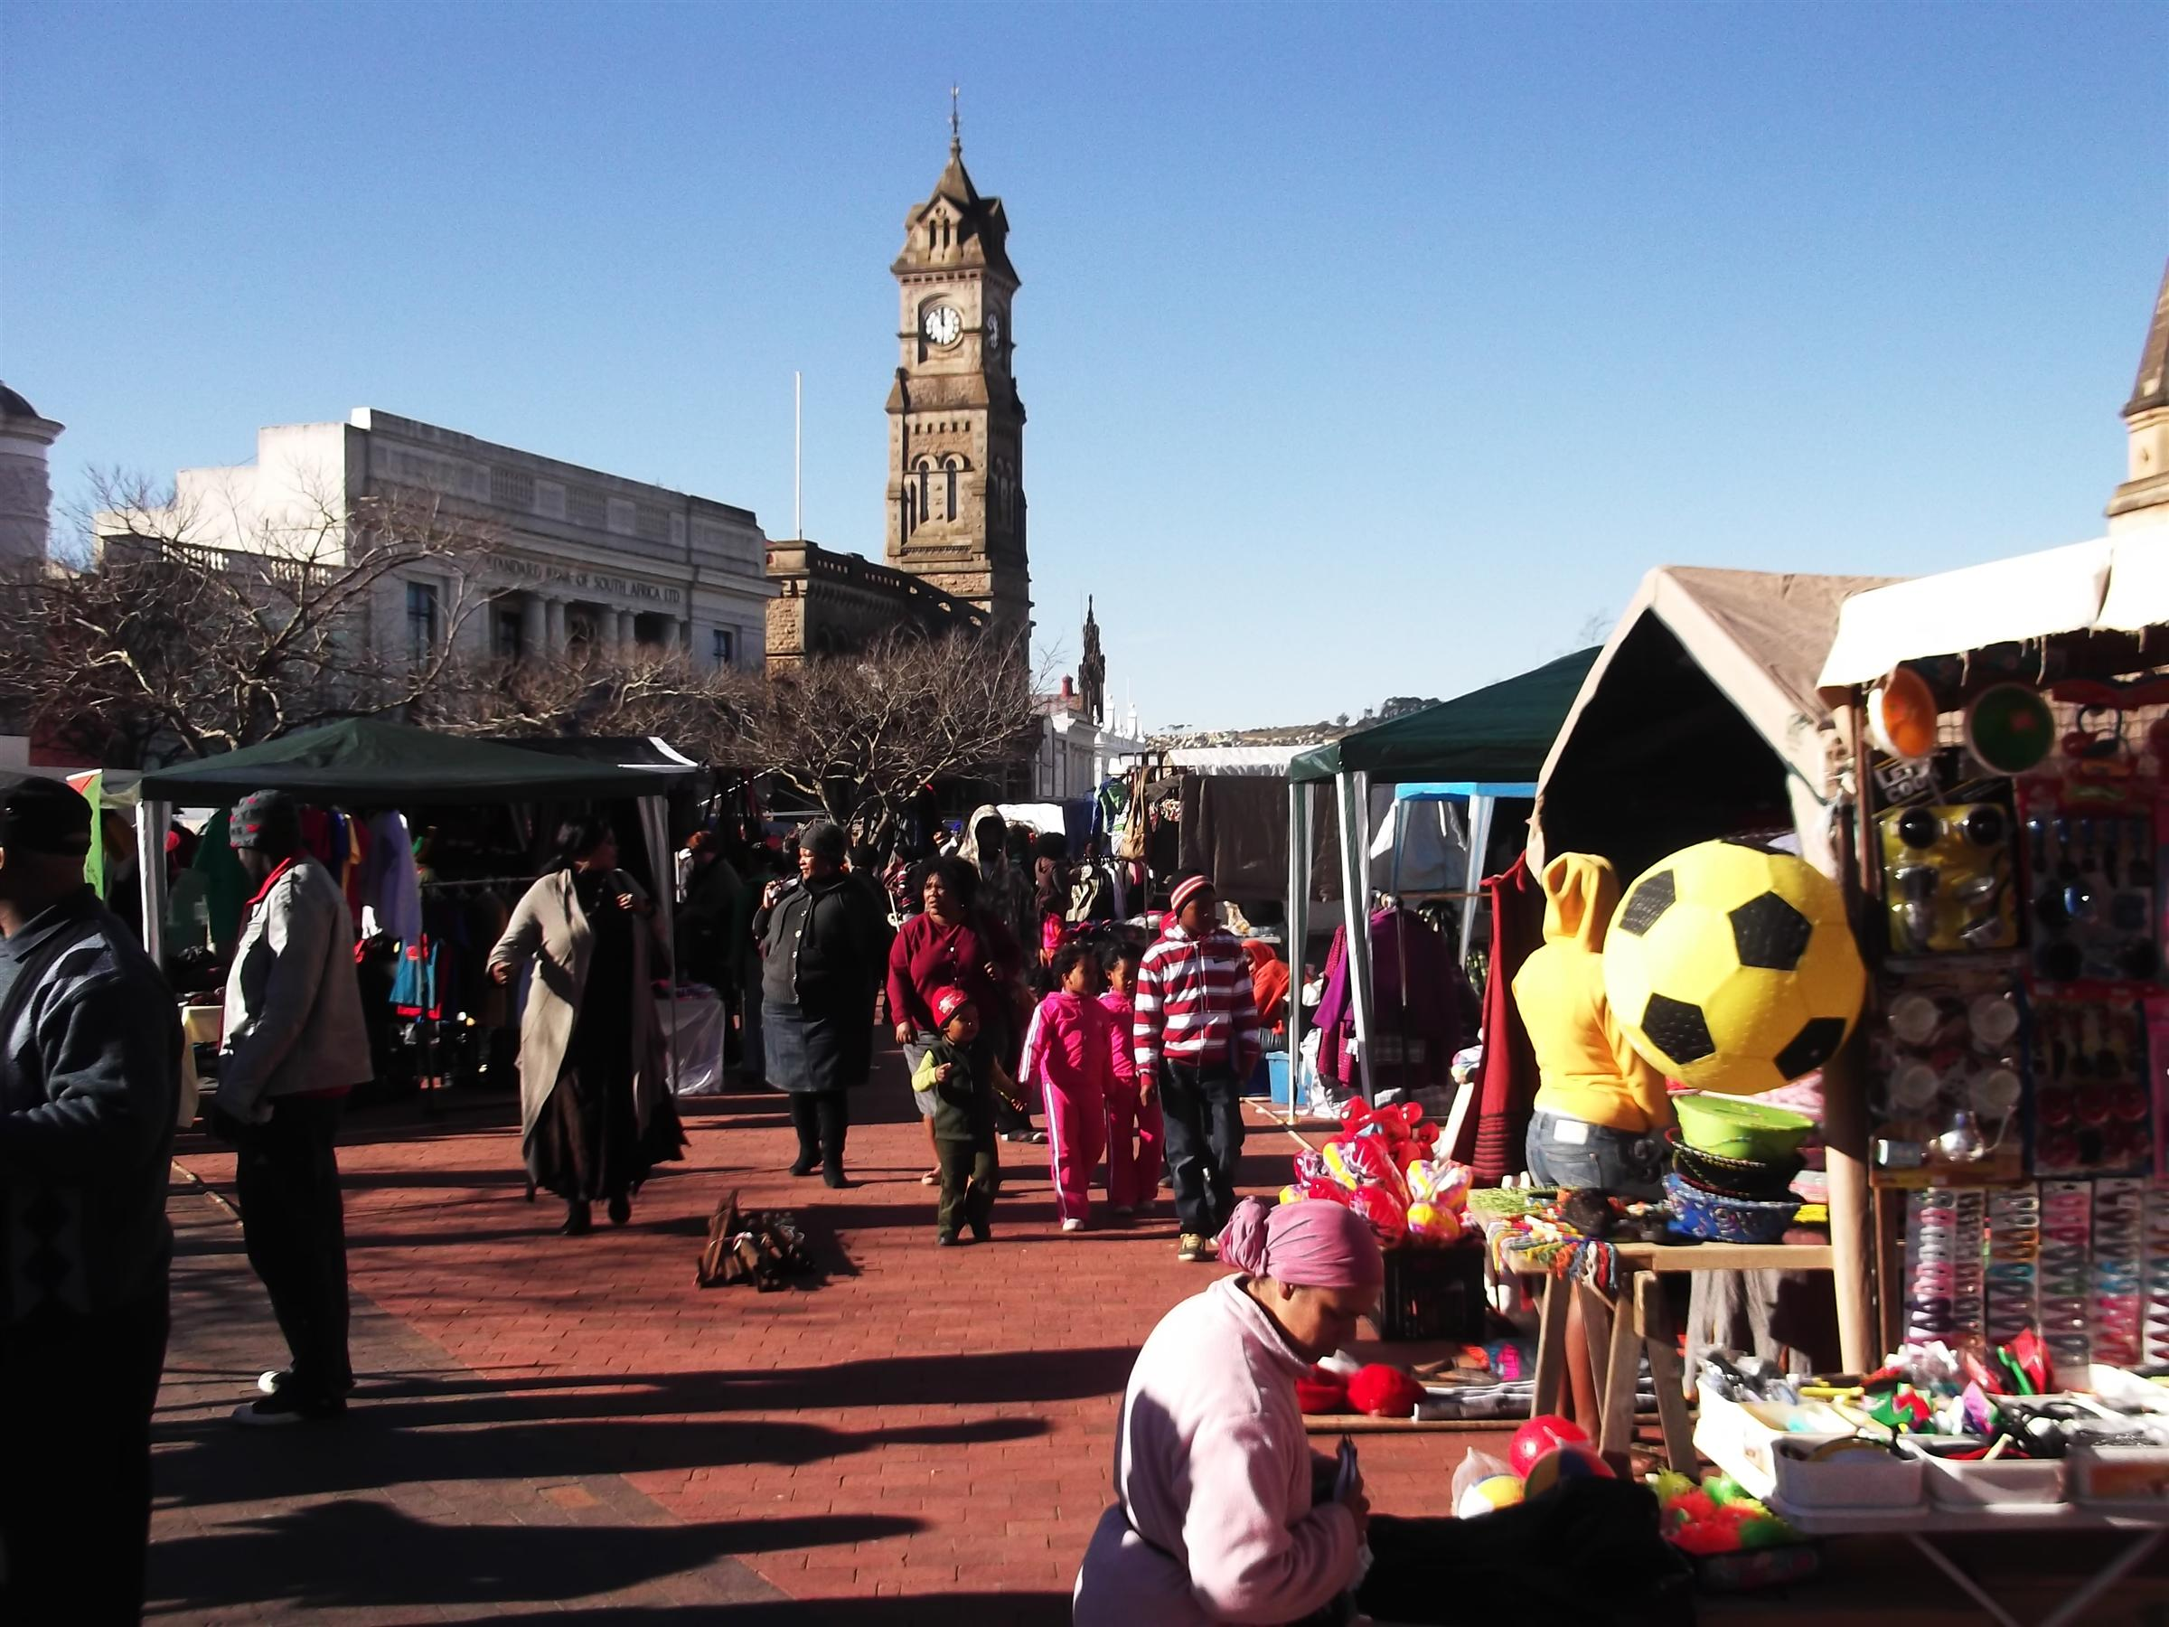
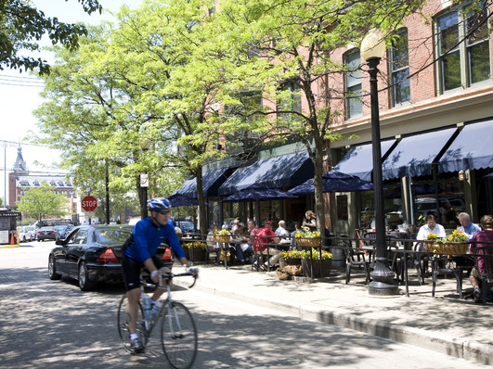
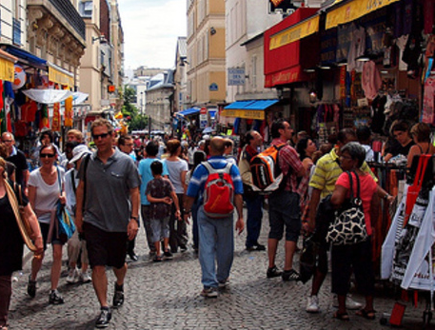
Collectively Being and Creating the Urban Planning Professionals We Need to Realise the 2030 NDP Vision
Final Draft
January 2013

Slide 2
SECTIONS
Section 1: Background
Section 2: Development of an
Urban Planning Professional
Section 3: The Role of Institutions
Section 4: Collective Action

Slide 3
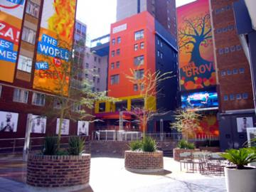
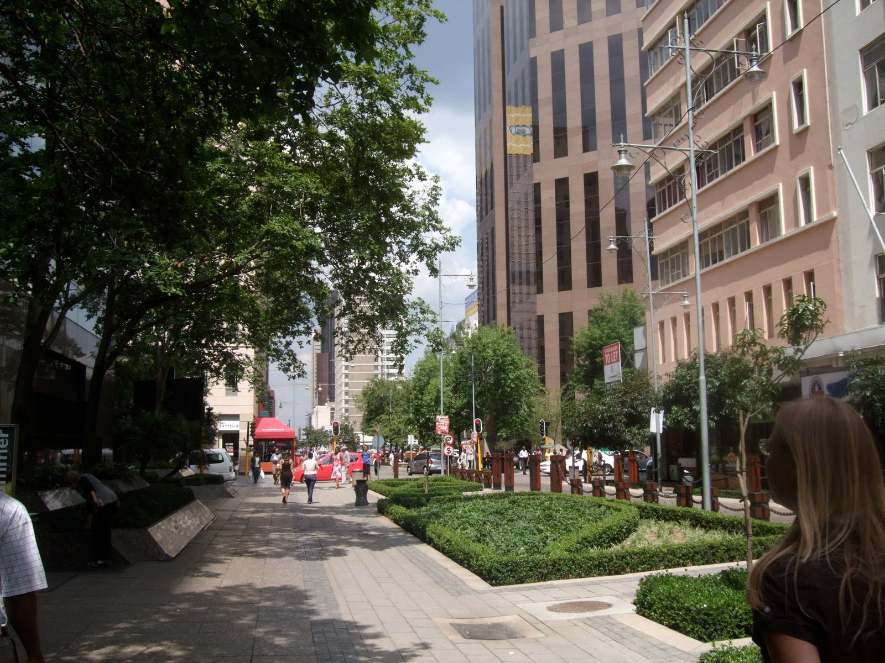
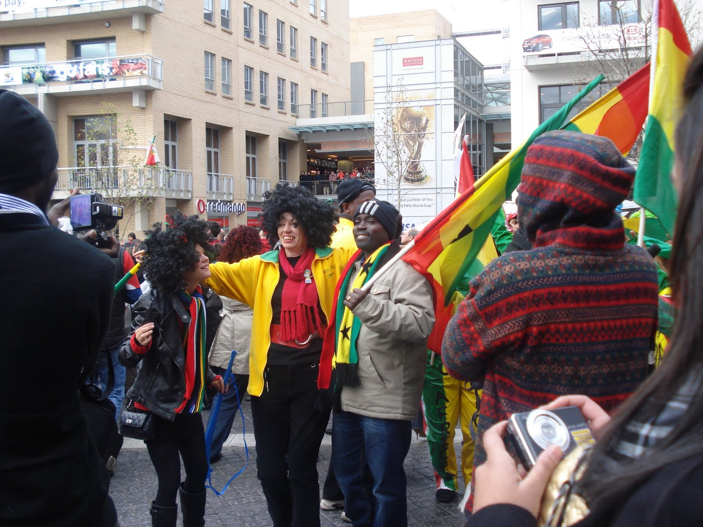
National Development Plan’s (NDP) 2030 Vision for South Africa’s Urban Areas:
VIBRANT
SUSTAINABLE
EQUITABLE
INCLUSIVE

Slide 4
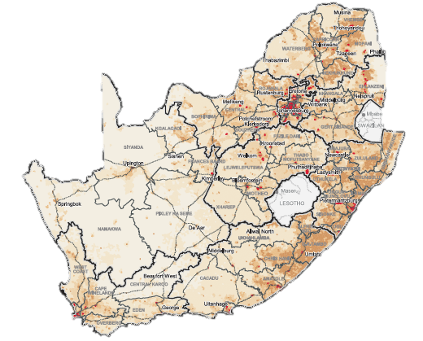
The realisation of this desired urban transformation requires significant spatial restructuring of the country’s urban areas
COMPACT CITIES
Play
Play
Public Transport
Home
Work
Home
Work

Slide 5
The Urban Networks Strategy (UNS) provides the overarching framework for this transformation
The UNS evolved in the National Treasury from, amongst other, reflections on, and work done in the Neighbourhood Development Programme (NDP)
Key amongst these was the realisation that public-led infrastructure investment, irrespective of how big and well-intended it may be, may not have the desired collective transformative impact
UNLESS
it is guided by plans that are based on the principles that have driven urban structuring and city building since the dawn of time, i.e.:
Diversity
Adaptability
Vibrancy
Conectivity
Resilience
Choice
Balance
All within a structuring, enabling & responsive framework of planned public infrastructure investment

Slide 6
The UNS seeks to put in place, through well-planned and targeted public investment, a resilient skeleton of:
Nodes with ample public space
&
Connecting routes serviceable by public transport, which act as a guiding framework for private, public and communal land development

Slide 7
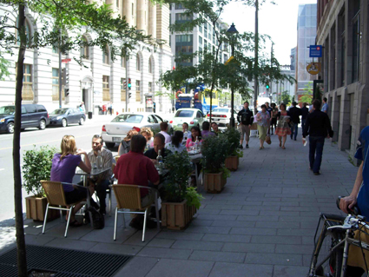
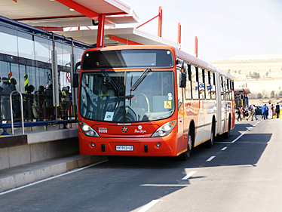
Implementing the UNS
The Urban Networks Strategy (UNS) will be implemented through:
The identification and development of intensive, high-density mixed-land use, diverse, walkable, compact and lively nodes in townships & suburbs
The development of safe, reliable, affordable and efficient public transport routes and services that can ensure the spatial, social, economic & cultural link-up of these nodes

Slide 8
Implementing the UNS
In order to implement the UNS, the following needs to be put in place:
A guiding, enabling & regulatory legal and policy framework
A series of interconnected short, medium and long-term strategic spatial & sector plans
Public & Private Sector investment and property development in accordance with plans

Slide 9
The Human Dimension
The three core requirements for the implementation of the UNS are in turn dependent on, amongst others, dedicated, competent, ethical and professional Urban Planning Professionals in both the public and the private sector to:
Prepare and implement the necessary plans
Provide politicians with the necessary information to secure their buy-in and support for the plans
Advice investors and property developers to invest in accordance with the plans
Research Institutions
Developers
Municipal-ities
Urban Planning Professionals
Politicians
Communities
National Government Departments
NGOs
Universities
Provincial Government Departments

Slide 10
The Challenge
Despite the key roles they can play, past experience with post-1994 urban restructuring programmes, including the Neighbourhood Development Programme, revealed that the kind of Urban Planning Professionals the UNS will require, are (1) in short supply, and (2) often do not act in accordance with their credo and/or competence
Whatever the true picture and the reason for this state of affairs, the UNS will require the right kind of urban planning professionals, and hence ways will need to be found to ensure that they:
Are competent and willing to play their part,
Improve and continually improve their skills,
Act within the ethical frameworks that their professions were built on and stand for, and
Assist in the development of their fellow professionals

Slide 11
SECTIONS
Section 1: Background
Section 2: Development of an
Urban Planning Professional
Section 3: The Role of Institutions
Section 4: Collective Action

Slide 12
Being Competent
An Urban Planning Professional is more than the holder of a specialised set of skills and knowledge…
10%
Where “competency
interventions” are usually
targeted at…
Skills & experience– Technical, communication, management, research, etc.
Domain specific
knowledge, expertise and specialisation
Where inspired, innovative and collaborative approaches to “competency
intervention” can have a significant impact…
Beliefs about ability of self
and profession
Passion and motivation
Willingness to take risk,
innovate
World view, values, caring
Preferences, personality,
brain profile
Sense of being valued, recognised, supported
90%

Slide 13
Becoming Competent
Making an impact
Sense of achievement
Adding value through career-phases Giving back to the profession and others
Sense of purpose
Typical aspects that facilitate and jump-start individual growth, action and innovation….
Opportunities to take risk
Experiencing a sense of urgency, value
A balance between stability and creative turmoil
High levels of autonomy
Tolerance for mistakes
Motivation and belief about impact
A caring, inclusive worldview
Participation in active social networks
Skills and experience
Sound knowledge base
Competency development as a process of life-long learning

Slide 14
SECTIONS
Section 1: Background
Section 2: Development of an
Urban Planning Professional
Section 3: The Role of Institutions
Section 4: Collective Action

Slide 15
The Role of Institutions
International and local literature and examples of improving, strengthening and deepening professional groups’ skills, values and behaviour, suggest that becoming and being a competent urban planning professional is a holistic social process that:
Starts with a quality academic qualification and entails a lifetime of continuous, formal and informal learning
Flourishes in organisational environments that are supportive, enabling and innovative, yet clear as to what is ‘right’ and ‘wrong’
Requires integration between:
The various components of the profession, i.e. students, academics, practitioners and professional bodies
The organisations they work in (i.e. different spheres of, and sectors in government, and the private sector) and
The communities and society they serve
Is regulated by statutory professional bodies and nurtured and enhanced by voluntary professional bodies
Offers value to the professional over her/his lifetime, in the form of knowledge, skills, collegiality, status, the opportunity to ‘give back to the profession’, and finally, to retire with a feeling of ‘a life well lived and a community and city well served’

Slide 16
The Role of Institutions
Institution | Role/Contribution
 |  | Education & Research | Service to society programs | Internships | Mentoring | Awards | Recognition (titles) | Building the profession | Work reservation | Providing virtual information sharing spaces
 | Universities | ••••• | ••••• | •••• | ••••• | ••••• | ••••• | •••• | • | •••••
 | Municipalities | •• | •• | ••••• | •••• | ••• | •• | •• | ••••• | ••
 | National & Provincial Gov Departments | •• | •• | ••••• | •••• | ••• | •• | •• | ••••• | ••
 | Professional Bodies | •••• | •••• | •••• | ••••• | ••••• | ••••• | ••••• | ••••• | •••••
 | Developers | • | •• | ••• | ••••• | ••• | •••• | • | • | •
 | Investment houses | • | •• | ••••• | ••• | •• | •••• | • | • | •
 | Planning firms | •• | ••• | ••••• | ••••• | ••••• | ••••• | ••••• | ••••• | ••
 | Associations and Networks | •••• | •••• | •••• | ••••• | ••••• | ••••• | ••• | • | •••••
 | NGOs | ••••• | ••••• | ••••• | ••••• | ••••• | ••••• | • | • | •••••

Slide 17
The Role of Institutions
Providing virtual information sharing spaces
Education & Research
Work reservation
Service to society programmes
The role/contribution varies per institution
Building the profession
Internships
Recognition/Titles
Mentoring
Awards

Slide 18
SECTIONS
Section 1: Background
Section 2: Development of an
Urban Planning Professional
Section 3: The Role of Institutions
Section 4: Collective Action

Slide 19
The Power of Collective Action
International and local literature and examples of improving, strengthening and deepening professional groups’ skills, values and behaviour, suggest that becoming and being a competent urban planning professional can be enhanced by:
Strengthening university departments offering professional degrees by providing more/better facilities, staff and/or funds for research
Instituting ‘service to society’ through structured university/student-community engagements/service periods
Setting up focussed mentoring and internship programmes
Putting in place desirable awards for different categories of excellence in the profession
Endowing exemplary professionals with titles that recognise, proclaim and celebrate their achievements
Strengthening professional bodies, and assisting them to enhance the profile of the profession amongst other professional groupings and society at large
Limiting certain types or categories of work to professionals that (1) have achieved certain levels of competence, and (2) maintain and expand their skills set through continued professional development
Providing real and virtual spaces for posting and sharing information, and establishing services that do so through the use of social media

Slide 20
The Power of Collective Action
International and local literature on collective endeavours in, between and amongst institutions suggest that this can be undertaken by:
Existing statutory and voluntary professional bodies improving and/or enhancing their existing and generic functions and activities and/or taking on new specialised functions, such as:
The establishment of new mentoring programmes
The institution of awards
The expansion of their web-based functionality and social media offerings and/or
The creation of special interest/focus groups, i.e. youth, women and rural-based professionals
A new entity that provides area/domain-specific knowledge-sharing or networking services in collaboration with existing entities and bodies

Slide 21
The Power of Collective Action
Example: Taking the first option: Institutions collectively agree to focus on four areas (red = primary role/contribution; orange = secondary role/contribution)
Actors and Institutions | Role/Contribution
 |  | Education & Research | Service to society programs | Internships | Mentoring | Awards | Recognition (titles) | Building the profession | Work reservation | Providing virtual sharing spaces
 | Universities | ••••• | ••••• | •••• | ••••• | ••••• | ••••• | •••• | • | •••••
 | Municipalities | •• | •• | ••••• | •••• | ••• | •• | •• | ••••• | ••
 | National & Provincial Gov Departments | •• | •• | ••••• | •••• | ••• | •• | •• | ••••• | ••
 | Professional Bodies | •••• | •••• | •••• | ••••• | ••••• | ••••• | ••••• | ••••• | •••••
 | Developers | • | •• | ••• | ••••• | ••• | •••• | • | • | •
 | Investment houses | • | •• | ••••• | ••• | •• | •••• | • | • | •
 | Planning firms | •• | ••• | ••••• | ••••• | ••••• | ••••• | ••••• | ••••• | ••
 | Associations and Networks | •••• | •••• | •••• | ••••• | ••••• | ••••• | ••• | • | •••••
 | NGOs | ••••• | ••••• | ••••• | ••••• | ••••• | ••••• | • | • | •••••

Slide 22
The Power of Collective Action
Providing virtual sharing spaces
Education & Research
Service to society programmes
Work reservation
Level of impact without collective focus
Building the profession
Internships
Enhancement of impact through collective focus
Recognition/Titles
Mentoring
Awards

Slide 23
The Power of Collective Action
Boosting both Urban Planning Professionals’ individual competence & the collective competence of Urban Planning Professionals through collective action
Practical abilities (includes technical ability & personal attributes to function as a professional)
Conceptual, strategic and ethical qualities & abilities | - + | + +
 | - - | + -
Individual Growth path
Individual Growth path
Individual Growth path
Individual Growth path
Individual Growth path
Individual Growth path

Slide 24
Summary
Status Quo
Desired Future
Lack of Collaboration and Collective focus and endeavour in, between and amongst Institutions…
Starting with...
Collective, Collaborative, Supportive and focused action in, between and amongst Institutions!
City Planning and Development that does not shake the boat, that retains the status quo…
City Planning and Development in accordance with the UNS and in pursuit of the NDP!
And getting to…

